Slide 1

Presentation: Test Launch Findings

Slide 2
Rolling out tabletop menu tablets to assist customers with quick, easy ordering options. Implementing menu tablets at tables and digitizing the ordering process will speed up service and other processes. It will allow us to turn tables more quickly and serve more guests.
Summary

Slide 3
The goals of the projects were to
Implement rollout of tabletop menu tablets at two of our restaurant locations with little or no technical issues.
Decrease average table turn time by approximately 30 minutes
Cut food waste by 25%
Increase average daily guest counts by 10%.
Decrease employee burnout and turnover
Reduce the number of negative customers reviews
To turn tables more quickly and serve more guests
Overview

Slide 4
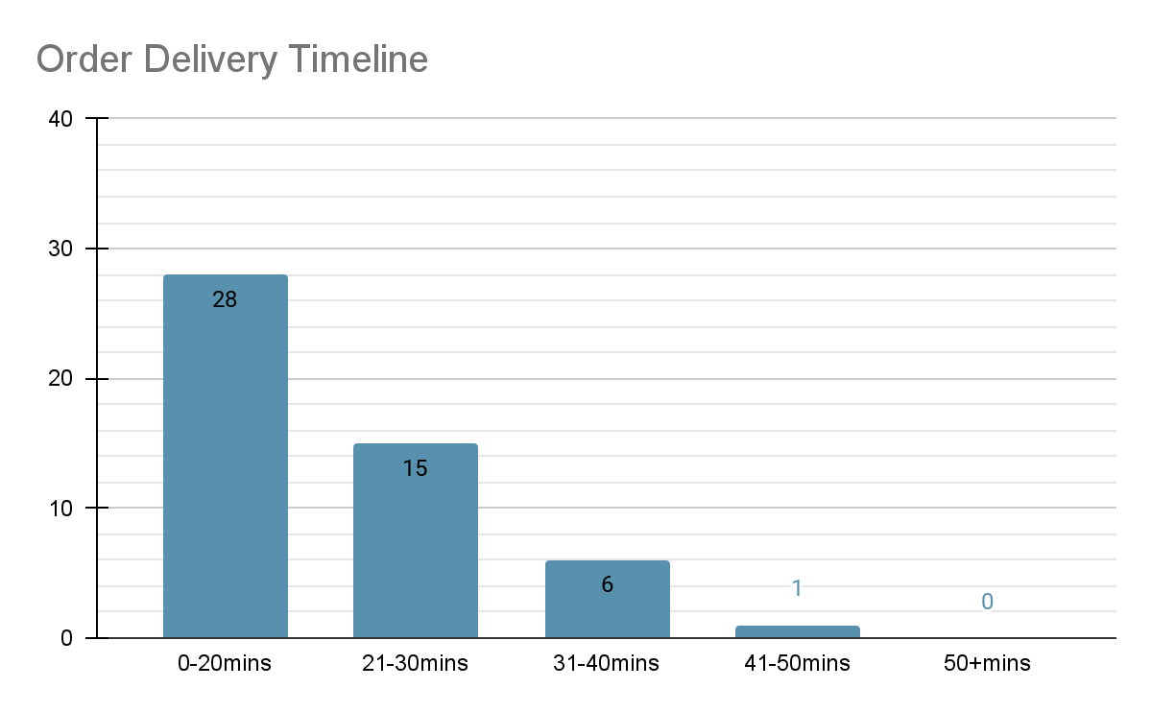
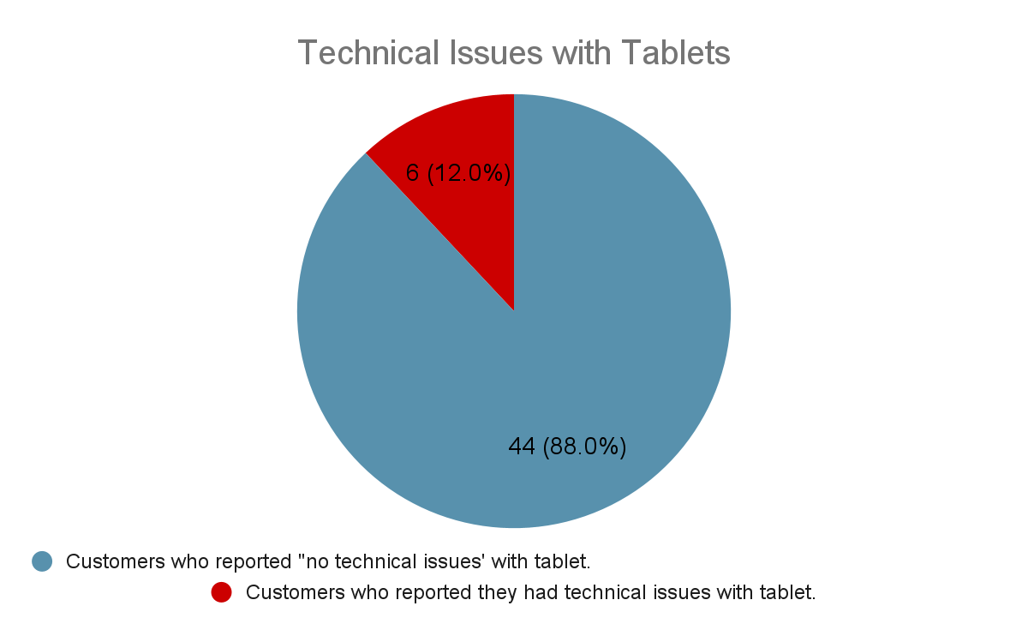
Findings

Slide 5
According to the customers survey, the tablets installation was a success, customers were able to order directly from the tablets, even multiple orders were made. The table turn time however didn’t reduce as supposed and there some technical issues were still recorded. With regards to these, below are recommendations for continuous improvement:
Constant routine maintenance check on tablets should be ensured. Also, process manual should be updated so that the solution is easy to find next time that issue comes up.
Next Steps

Slide 6
Technical issues affecting easy navigation should be looked into. An App demo on the landing page should also be considered.
The issue of orders being sent back will be looked into to reduce the lobby wait time
The issue of order accuracy should be prioritized for further analysis.
Next Steps

